Slide 1
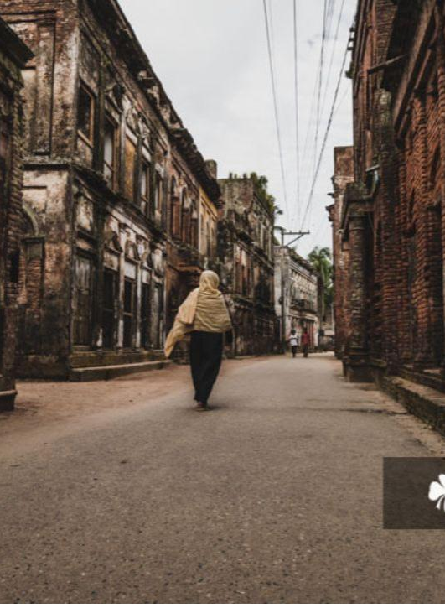
Panama City: A Historic Hub of Culture
Beautiful Bangladesh

Slide 2
Historical information
Panam Nagar was an ancient settlement in Bangladesh, situated at Sonargaon Upazila in Narayanganj District.
Later in the 15th century Isa Khan Masnad-e-Ala, the leader of the Baro-Bhuyans, founded the Bhati area here and gave Panam the title of the capital; Sonargaon was thereafter governed from Panam.

Slide 3
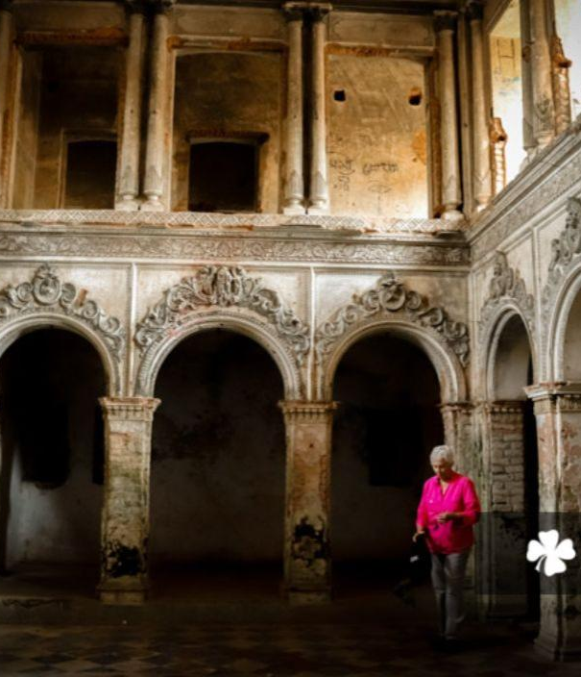
This historic area has become abandoned city space in the post-partition era, during 1947-1965.

Slide 4
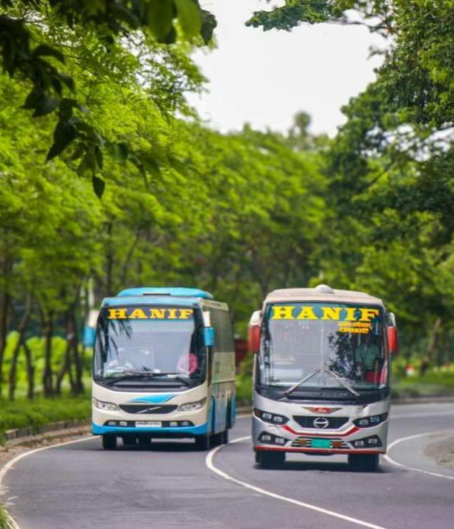
The journey will start on 20 January 2025. We will go to Dhaka by Hanif bus. We have booked a room at Hotel Ornate where we will stay for 2 nights.

Slide 5

We will reach Dhaka in the morning, have breakfast and go out to explore Panam Nagar

Slide 6
Thank you
We hope that All of you will join our Panam Nagar journey.

